Slide 1

Please download the PSETs now as we will be working on them during section!
CS50 students
Hangman!
Project brainstorming!
Another new programming language

Slide 2
cs50.ly/section_attendance

Slide 3
cs50 section 7
SQL
Andrew Holmes 2023

Slide 4
Why databases / SQL?
Persistent data with fast access
Server-side data querying
Works nicely with parallelism & distributed systems

Slide 5
Today’s plan
SELECT
03
Complex queries
01
02
CREATE/INSERT
04
PSET
Get data
Nested queries, JOINs
Modifying data
Doing the thing ☺

Slide 6
01
SELECT
Getting data

Slide 7
Database structure
SELECT
Database file
Table: pokemon
Table: trainers
id | name | type
1 | Pikachu | Electric
2 | Oshawott | Water
3 | Pidgey | Normal
id | name
1 | Andrew
2 | Carter
column

Slide 8
Database structure
SELECT
Database file
Table: trainers
Table: pokemon
id | name
1 | Andrew
2 | Carter
id | name | type
1 | Pikachu | Electric
2 | Oshawott | Water
3 | Pidgey | Normal
Hidden table: sqlite_schema
column
Notes:
Also called sqlite_master among other names I believe

Slide 9
Dataset
Table: pokemon
SELECT
id | name | type_1 | type_2 | level
1 | Pikachu | Electric | None | 24
2 | Charizard | Fire | Flying | 98
3 | Oshawott | Water | None | 100
4 | Mew | Psychic | None | 80
5 | Mudkip | Water | None | 8
6 | Cyndaquil | Fire | None | 12
7 | Pidgey | Flying | Normal | 6

Slide 10
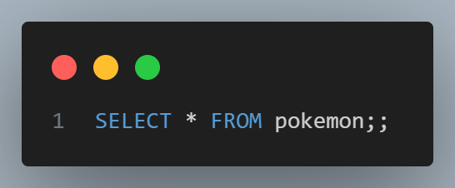
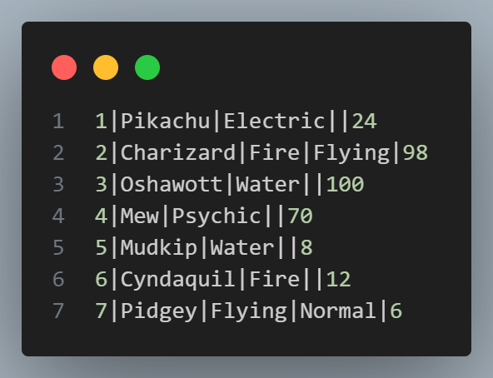
SELECT
SELECT
SELECT keyword for getting information!
FROM keyword to decide which table to look for data in

Slide 11

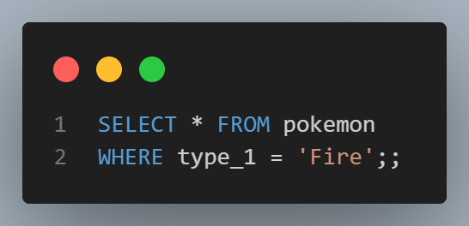

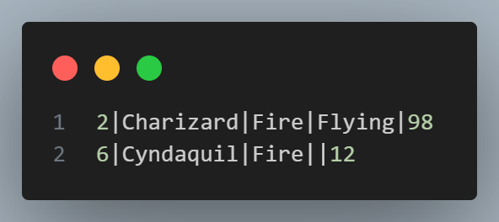
WHERE
SELECT
WHERE keyword for applying restrictions!

Slide 12
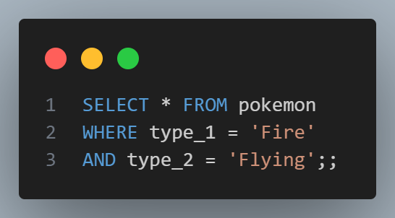
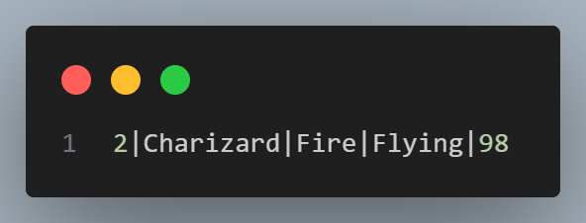
AND
SELECT
AND keyword for applying multiple restrictions!

Slide 13
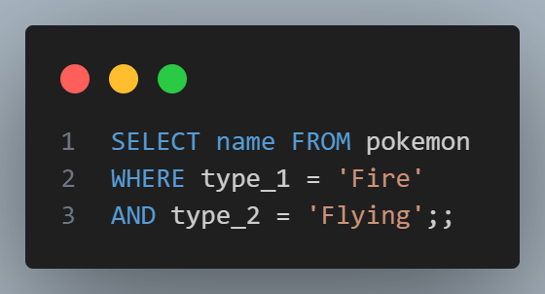
SELECTING individual columns
SELECT

Slide 14
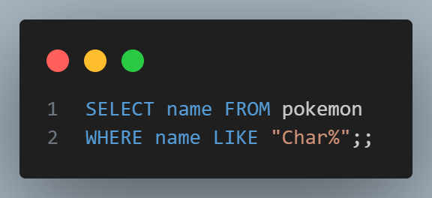


Using LIKE and %
SELECT

Slide 15

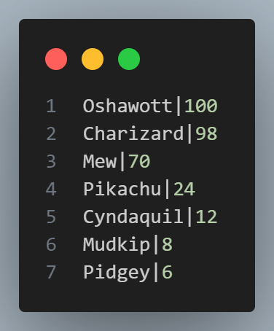
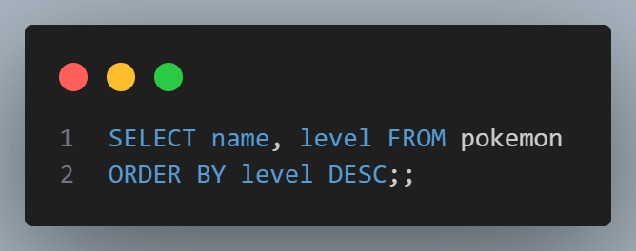
Ordering
SELECT
multiple columns
ORDER BY … DESC

Slide 16
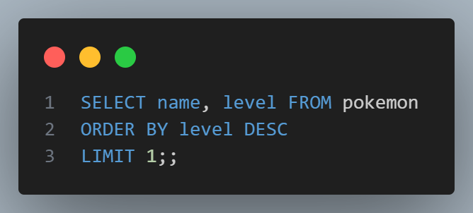
LIMIT
SELECT
When only the finest will do…

Slide 17
MOOORE KEYWORDS
SELECT
AND
BETWEEN
COUNT
GROUP BY
HAVING
SUM
AVG
JOIN
INSERT
LIKE
LIMIT
MAX
WHERE
DELETE
MIN
OR
ORDER BY
ROUND
DISTINCT
UPDATE

Slide 18
02
INSERT/CREATE
Putting stuff in tables

Slide 19

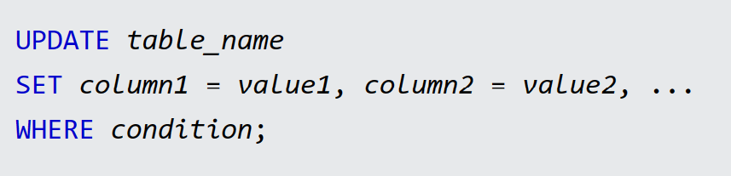
INSERT
Inserting

Slide 20
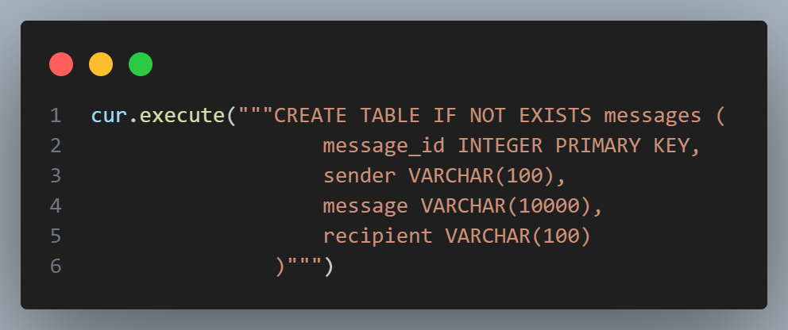
CREATE
Inserting
Notes:
Snipper of Python code from one of my 262 projects, to show both CREATE TABLE, IF NOT EXISTS and hint towards using SQL in Python in future weeks.

Slide 21
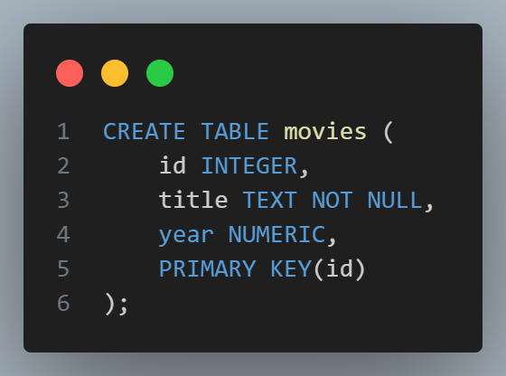
CREATE
Here’s one of the tables from the movies PSET.
To view how tables were created in a database, we use .schema

Slide 22
KAHOOOOT
It’s time.
Note: This will use the ‘movies’ table just shown. Feel free to take a photo, or just remember the main details

Slide 23
03
Complex queries
Nested SELECTs, JOINs

Slide 24
Dataset
Table: pokemon
Queries
id | name | type_1 | type_2 | level
1 | Pikachu | Electric | None | 24
2 | Charizard | Fire | Flying | 98
3 | Oshawott | Water | None | 100
4 | Mew | Psychic | None | 80
5 | Mudkip | Water | None | 8
6 | Cyndaquil | Fire | None | 12
7 | Pidgey | Flying | Normal | 6

Slide 25
Dataset
Table: partnerships
Queries
poke_id | trainer_id
1 | 3
2 | 2
3 | 2
4 | 3
5 | 4
6 | 3
7 | 1
Table: trainers
id | name
1 | Carter
2 | Andrew
3 | Mark
4 | Phyllis

Slide 26
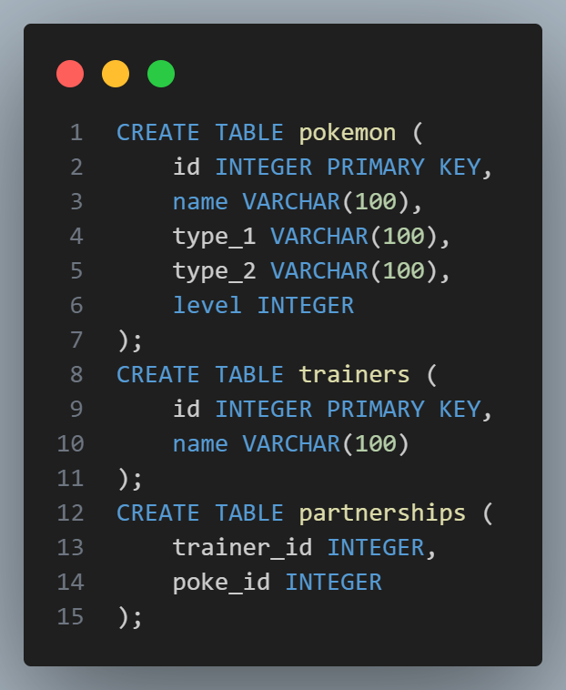
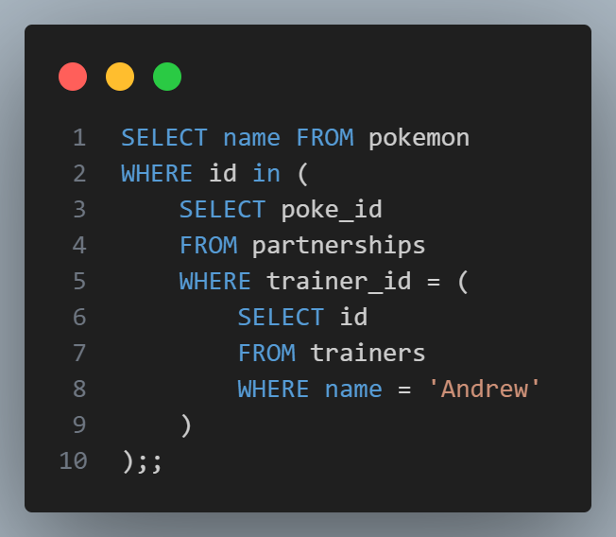
Trainers
Queries
Q: How do I get all pokemon that Andrew trains?

Slide 27
Association tables
Queries
Trainers
id
name
partnerships
trainer_id
pokemon_id
pokemon
id
Name
type_1
type_2
level
Known as an ‘association table’ or ‘junction table’
Q: When are association tables a good idea? Is this one good?

Slide 28
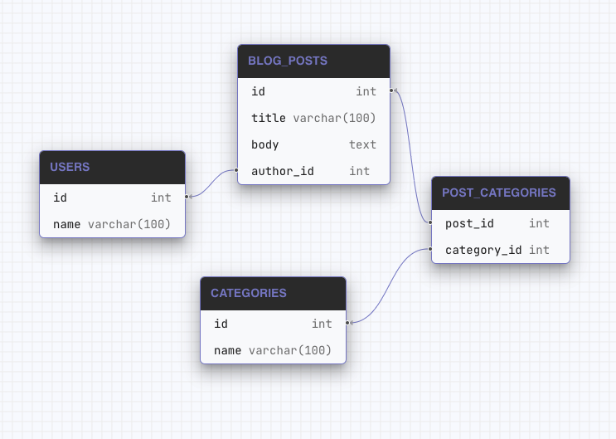
Association tables
Queries
Q: Is this a good usage of association tables?
A: Yes – post can be in many categories, and category can contain many posts. Many-to-many.
Notes:
Source: Applying Schemas | Atlas | Open-source database schema management tool (atlasgo.io)

Slide 29
Association tables
Queries
One-to-many: each trainer can have multiple pokemon, but each pokemon belongs to only one trainer
pokemon
id
name
type_1
type_2
level
trainer_id
Trainers
id
name
age

Slide 30
Association tables
Queries
movies
id
Name
year
association
movie_id
star_id
person
id
name
DOB
Many-to-many, use association tables!

Slide 31
JOINs
Table: everything
Queries
id | name | type_1 | type_2 | level | Trainer
1 | Pikachu | Electric | None | 24 | Mark
2 | Charizard | Fire | Flying | 98 | Andrew
3 | Oshawott | Water | None | 100 | Andrew
4 | Mew | Psychic | None | 80 | Mark
5 | Mudkip | Water | None | 8 | Phyllis
6 | Cyndaquil | Fire | None | 12 | Mark
7 | Pidgey | Flying | Normal | 6 | Carter

Slide 32
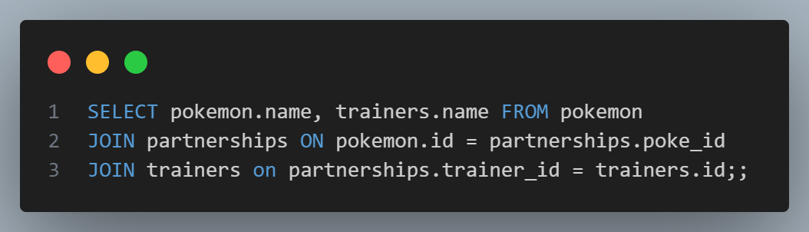
Dataset
Table: everything
Queries

Slide 33
JOINs
Queries
Trainers
id
name
partnerships
trainer_id
pokemon_id
pokemon
id
name
type_1
type_2
level
everything
id
name
Type_1
Type_2
Level
trainer_name

Slide 34
id | name | type_1 | type_2 | level
1 | Pikachu | Electric | None | 24
2 | Charizard | Fire | Flying | 98
3 | Oshawott | Water | None | 100
4 | Mew | Psychic | None | 80
5 | Mudkip | Water | None | 8
6 | Cyndaquil | Fire | None | 12
7 | Pidgey | Flying | Normal | 6
poke_id
1
2
3
4
5
6
7
trainer_id
3
2
2
3
4
3
1

Slide 35
Dataset
Table: everything
Queries
id | name | type_1 | type_2 | level | trainer_id
1 | Pikachu | Electric | None | 24 | 3
2 | Charizard | Fire | Flying | 98 | 2
3 | Oshawott | Water | None | 100 | 2
4 | Mew | Psychic | None | 80 | 3
5 | Mudkip | Water | None | 8 | 4
6 | Cyndaquil | Fire | None | 12 | 3
7 | Pidgey | Flying | Normal | 6 | 1

Slide 36
Dataset
Table: everything
Queries
id | name | type_1 | type_2 | level | Trainer
1 | Pikachu | Electric | None | 24 | Mark
2 | Charizard | Fire | Flying | 98 | Andrew
3 | Oshawott | Water | None | 100 | Andrew
4 | Mew | Psychic | None | 80 | Mark
5 | Mudkip | Water | None | 8 | Phyllis
6 | Cyndaquil | Fire | None | 12 | Mark
7 | Pidgey | Flying | Normal | 6 | Carter
Q: This isn’t quite accurate, what does it actually look like?

Slide 37
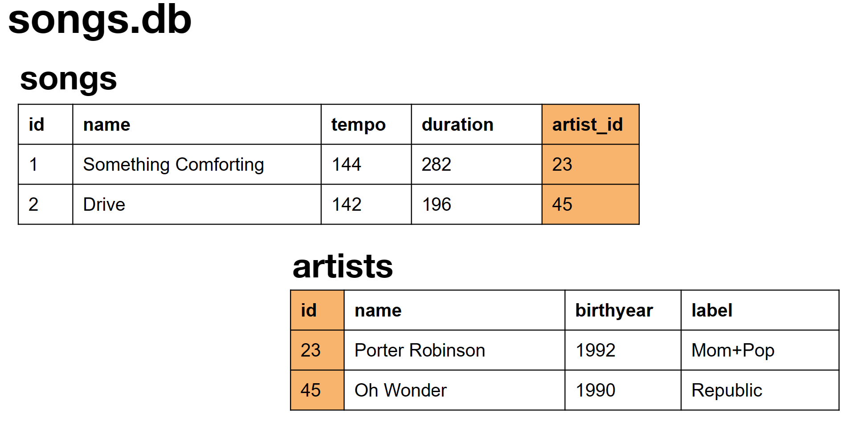
CS50 official slides save the day
Queries

Slide 38
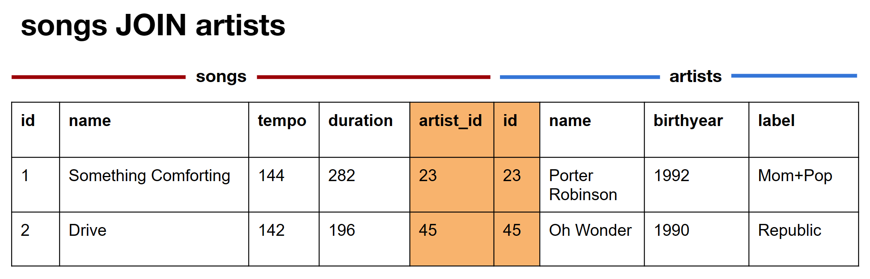
CS50 official slides save the day
Queries

Slide 39
Dataset
Queries
Table: everything (extended)
name | type_1 | type_2 | level | trainer | badges | champion | Pokedex
Pikachu | Electric | None | 24 | Mark | 3 | FALSE | 48
Charizard | Fire | Flying | 98 | Andrew | 8 | TRUE | 497
Oshawott | Water | None | 100 | Andrew | 8 | TRUE | 497
Mew | Psychic | None | 80 | Mark | 3 | FALSE | 48
Mudkip | Water | None | 8 | Phyllis | 0 | FALSE | 8
Cyndaquil | Fire | None | 12 | Mark | 3 | FALSE | 48
Pidgey | Flying | Normal | 6 | Carter | 0 | FALSE | 1

Slide 40
JOIN vs nested queries
Queries
JOINs are expensive! But sometimes necessary:
You want to retrieve data columns from more than one table,
e.g. trainer name and pokemon name in one query.
Want to exclude rows with missing IDs/connections between tables (see LEFT JOIN, INNER JOIN etc)

Slide 41
04
PSET
Week ahead

Slide 42
PSETs
PSET
Let’s work in partners on the PSET for a while!

